Slide 1
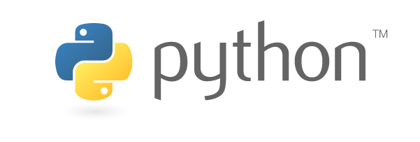
FAIM Python Workshop
General Introduction & OOP
benjamin.titze@fmi.ch
Facility for Advanced Imaging and Microscopy (FAIM)
24 July 2019

Slide 2

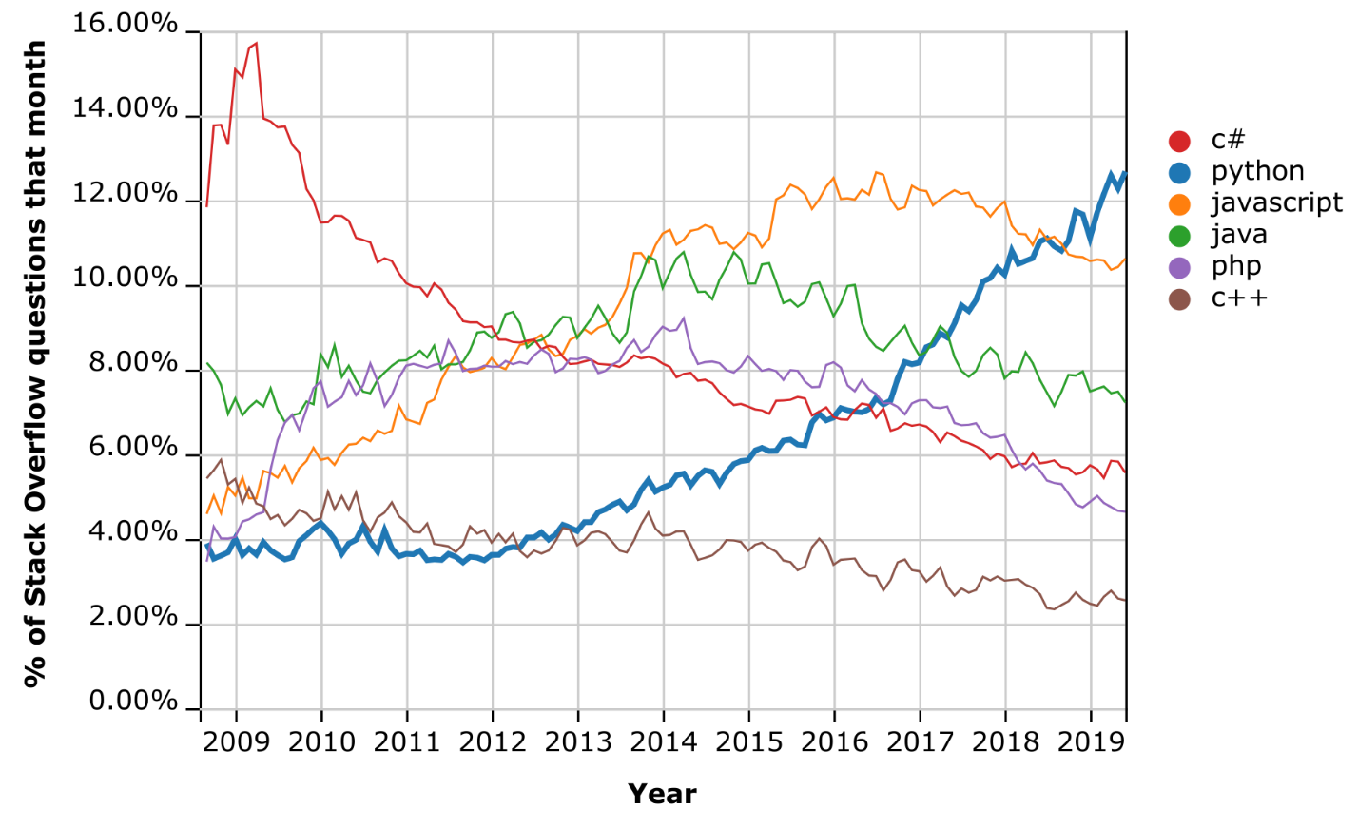
A brief history…
Started out as a “hobby programming project” to bridge the gap between shell scripts and C.
Named after the British comedy group ‘Monty Python’.
Python 1.0 – 1994
→ 1.x versions are obsolete
Python 2.0 – 2000
→ Latest and final: 2.7 in 2010
Python 3.0 – 2008
→ Currently 3.7 (June 2018)
Strong growth over the last decade.
Python is now a mainstream programming language alongside Java, C/C++/C#, JavaScript, …
Created by Dutch software developer Guido van Rossum at CWI, Amsterdam.
Released in 1991.
Van Rossum was Python’s BDFL (Benevolent Dictator for Life) until July 2018.

Slide 3
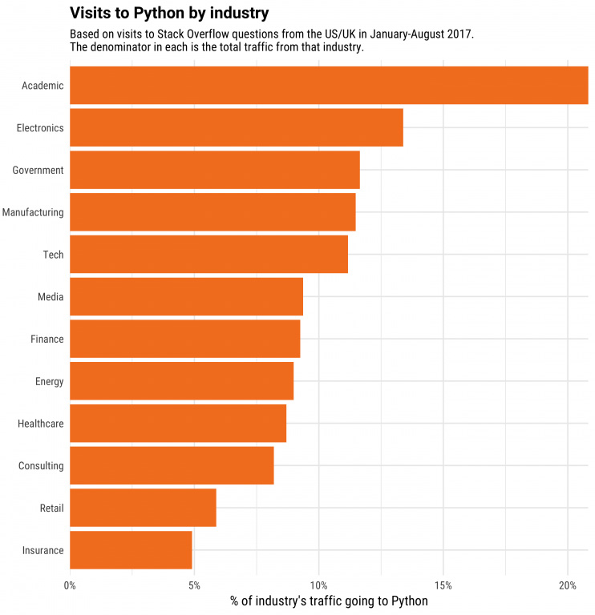
Why Python?
Python is a
general-purpose
interpreted
high-level
object-oriented
programming language.
Increasing use by large IT companies
Prominent examples:
Google, Amazon, Instagram, Dropbox, Spotify, Netflix…
Why Python?
Easy to learn
Fast development
Platform-independent
Great ecosystem: lots of third-party libraries, vibrant community.
But:
Slow compared to compiled languages, high memory consumption, runtime errors…
Source: https://www.peerbits.com/blog/factors-will-drive-python-growth-in-2018.html

Slide 4
Python 2 vs 3
Python 2 will become obsolete in the long run (won’t be maintained past 2020); Python 3 is the future.
→ https://python3statement.org and https://pythonclock.org !
If you start a project now, don’t use Python 2 unless you really have to.
Examples of differences:
Division operator: 5/2 yields 2 in Python 2, but 2.5 in Python 3.
print() is a function in 3.x; but in 2.x print is a statement.
print "Hello" in Python 2.x; print("Hello") in Python 3.x
print "Hello", to stay on the same line. In Python 3.x: print("Hello", end="")
Implicit str type in Python 2 is ASCII, in Python 3 it’s utf-8 (Unicode) by default:
print("こんにちは、世界！")
Ω = math.sin(θ) * Ŵ
Changed behaviour/naming of some functions:
xrange() vs range(); raw_input() vs input()
‘Future’ functionality can be made available to earlier versions:
For example: from __future__ import division

Slide 5
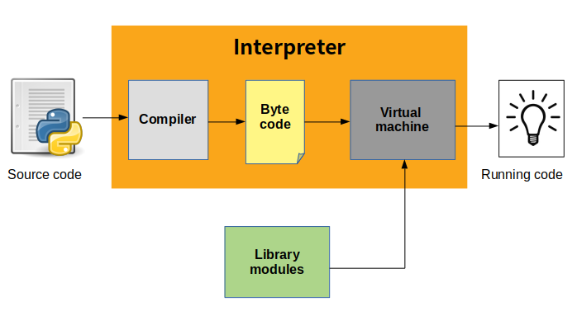
From source code to execution
The source code (*.py files) is not interpreted directly, but first compiled into byte code (*.pyc files), an intermediate lower-level language for faster execution.
Byte-code is interpreted on the Python Virtual Machine.
CPython:
The Python reference implementation in C, github.com/python/cpython)
Alternatives: Jython, Iron Python, PyPy…
Source: https://indianpythonista.wordpress.com

Slide 6
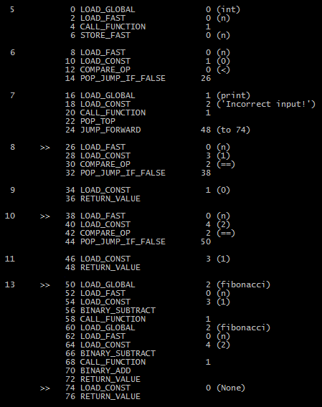
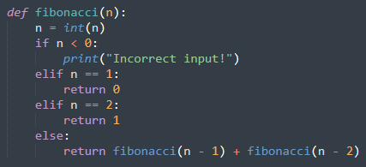
Byte code example
Bytecode in human-readable form:
Python source code
This function returns the nth Fibonacci number.
Disassembled with dis package:
https://docs.python.org/3/library/dis.html
Read more about this: https://opensource.com/article/18/4/introduction-python-bytecode

Slide 7
Installing and running Python / Editors and IDEs
Different options:
Installer from www.python.org (Python Software Foundation)
Choose version 3.x for your operating system. Let installer add Python to the system path.
Distribution:
Anaconda: www.anaconda.com – comes with lots of useful packages and tools preinstalled.
Or the minimalist Miniconda: just Python and the conda package manager
… or try it out online:
https://www.python.org/shell
https://www.pythonanywhere.com/
Test installation on the command line interface:
Typing python should start Python shell.
Try: import this and import antigravity
You may need to set environment variables manually.
What else do you need?
Good text editor with syntax highlighting: Notepad++, VIM, Emacs, Sublime Text, Atom, many others…
IDE – integrated development environment (optional): Spyder (comes with Anaconda), PyCharm, Ecplise + PyDev…
Jupyter Notebook

Slide 8
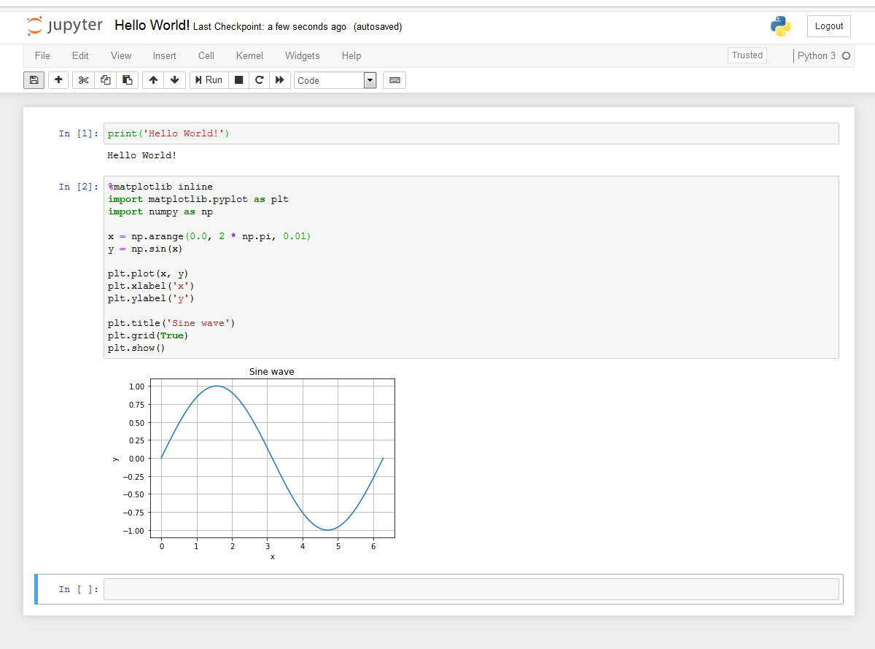
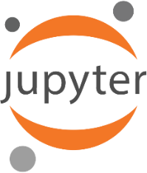
Jupyter notebook
Browser-based interactive programming environment (previously IPython Notebook)
Named after the core languages supported:
Julia, Python, and R.
A common tool for data science / scientific computing in both academia and industry.
Run from command line: jupyter notebook
If it’s not installed yet:
Install with: pip install jupyter
Notebook files: *.ipynb

Slide 9
Hands-on exercise I: Use Jupyter notebook and review basic syntax and language elements
Open a new Jupyter Notebook (Python 3)
Get familiar with the Jupyter Notebook
Write code that can do the following:
Ask the user for his/her name and age
Greet the user with his/her name
Check if the user’s name is a palindrome.
Check if the user’s age is a prime number.
Write functions is_prime() and is_palindrome() for the checks. Do not use any imports.
You can work with others or try it alone. We’ll then go through the code together (Review_Basics.ipynb). ☺

Slide 10
Virtual environments
Virtual environments allow you to use specific versions of Python and Python packages in isolation.
Different options for environments:
virtualenv
venv (new in Python 3.3)
conda
conda (from Anaconda) is both a package manager and an environment manager.
Let’s try it on the command line:
pip install virtualenv (if not installed yet)
virtualenv <..\path\to\venv>
virtualenv --python=python2.5 <..\path\to\venv>
(if python2.5 installed at system level, otherwise point to path: --python=\path\to\python2.5)
Alternatives:
python -m venv <..\path\to\venv>
conda create --name myenv [python=3.4]
conda create -n myenv python=3.4 scipy=0.15.0 [other packages]
Go to ..\path\to\venv\Scripts
activate (Prompt will show the new environment!)
deactivate
With conda:
conda activate myenv
conda deactivate

Slide 11
Package managers
Let’s try it on the command line:
pip install <package_name>
pip uninstall <package_name>
Upgrade to latest version:
pip install --upgrade <package_name>
Specific version:
pip install <package_name==1.7>
Install from requirements file (list of packages):
pip install –r requirements.txt
Similar with conda:
conda install [--name myenv] <package_name>
conda remove <package_name>
conda install <package_name=1.7> (single equal sign!)
conda install --file requirements.txt
Package managers install packages and their dependencies:
pip – Python’s default
conda – Anaconda’s package manager
If you activate virtual environment X and install packages, they will be only available in X.
This page may be helpful (under Windows): https://www.lfd.uci.edu/~gohlke/pythonlibs/
Provides binaries (wheel files) for installation with pip.

Slide 12
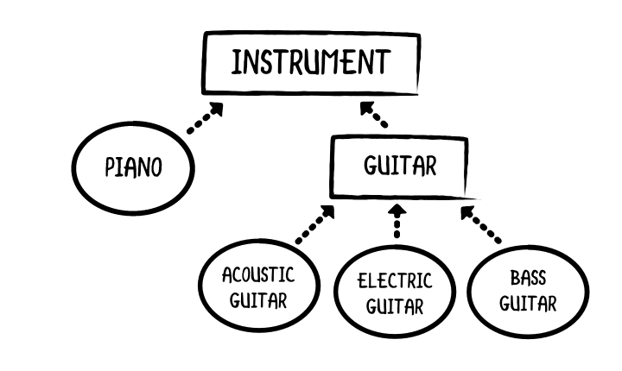
Object-oriented programming (OOP)
Bind together data and functions in logical units – for better organization and maintainability!
Terminology:
Classes and objects, instances of classes
In Python, everything is an object!
Four basic principles:
Encapsulation
Abstraction
Inheritance
Polymorphism
https://www.raywenderlich.com/599-object-oriented-programming-in-swift

Slide 13

Hands-on exercise II: Learn basics of OOP with classes for 3D shapes
We will work in an editor for this exercise and develop classes for 3D shapes. I will create the base class and the cube class and explain the basic concepts.
You will then try to create a sphere class.
Our 3D shape module should be able to do the following:
Manage 3D objects (cubes and spheres, but you can think of other shapes)
Calculate their surface areas and volumes
Calculate the distance between two objects
(Pretend to) draw them
We’ll go over the entire code together:
shapes.py, shapes-main.py
Optional: Use of ‘properties’ (advanced):
shapes_properties.py, shapes-main_properties.py

Slide 14
Hands-on exercise III: Trying out packages for text analysis, computer algebra, and networks
We will use Jupyter Notebook to try out the following packages:
TextBlob/NLTK
Simplified text processing (builds upon NLTK)
https://textblob.readthedocs.io
pip install –U textblob
python -m textblob.download_corpora
SymPy
Lightweight library for symbolic mathematics
https://www.sympy.org
pip install sympy
NetworkX
Creating, manipulating and analysing networks
https://networkx.github.io/
pip install networkx
→ See corresponding Jupyter notebooks!

